Slide 1
Data Coach | Steel Data Challenge 5-Pub Pricing Analysis
As the Pricing Analyst for 'Pubs "R" Us', a leading pub chain, I've embarked on an insightful journey to analyze and optimize our drink prices and sales. This project serves as a comprehensive exploration into the pricing strategies and their impact on our pub performance. Join me in this data-driven endeavor as we uncover key insights to enhance our business operations. Presented by : Sunil Kumar Pal

Slide 2
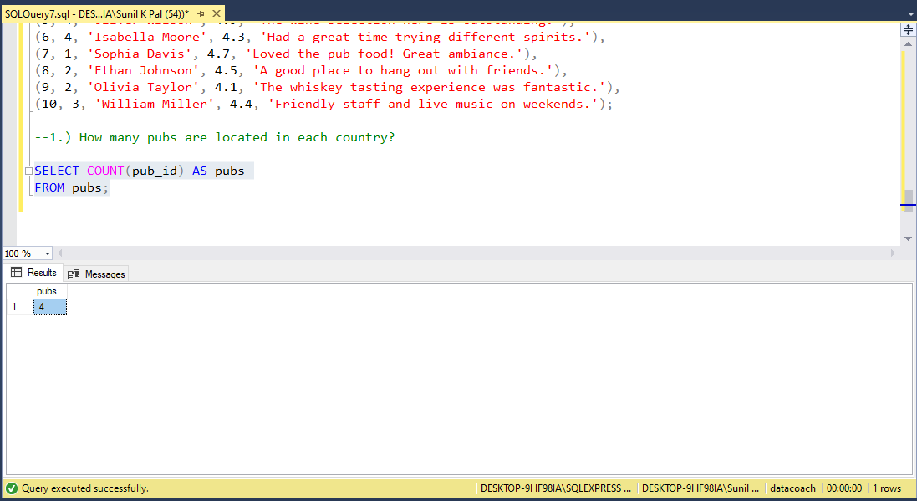
How many pubs are located in each country?

Slide 3
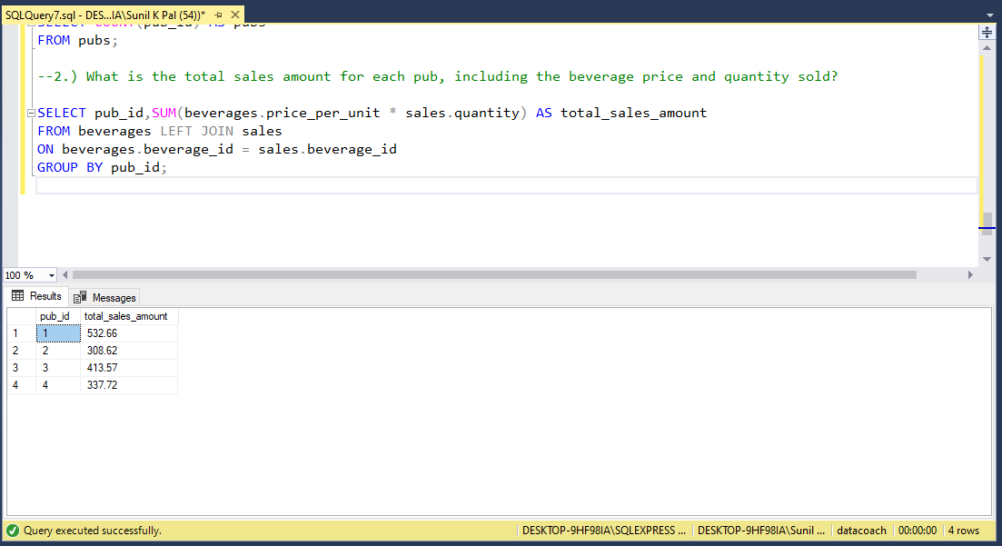
What is the total sales amount for each pub, including the beverage price and quantity sold?

Slide 4
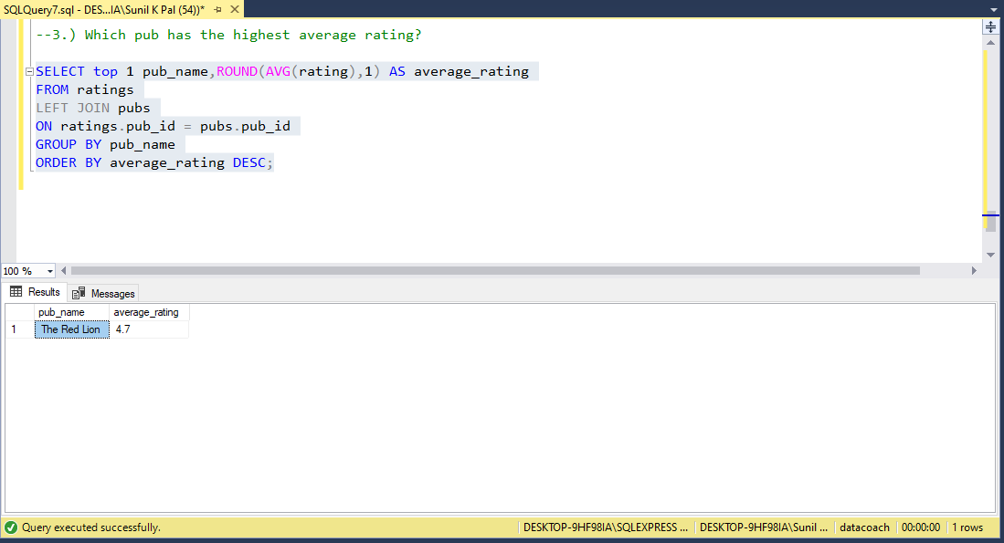
Which pub has the highest average rating?

Slide 5
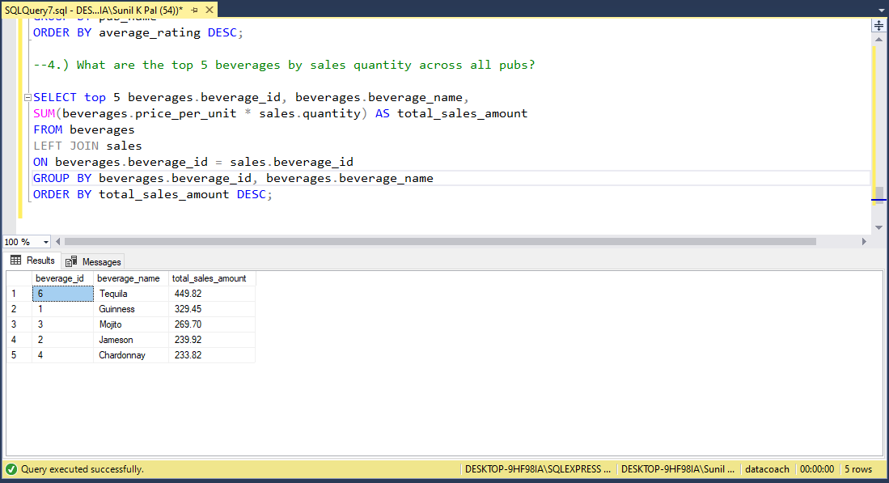
What are the top 5 beverages by sales quantity across all pubs?

Slide 6
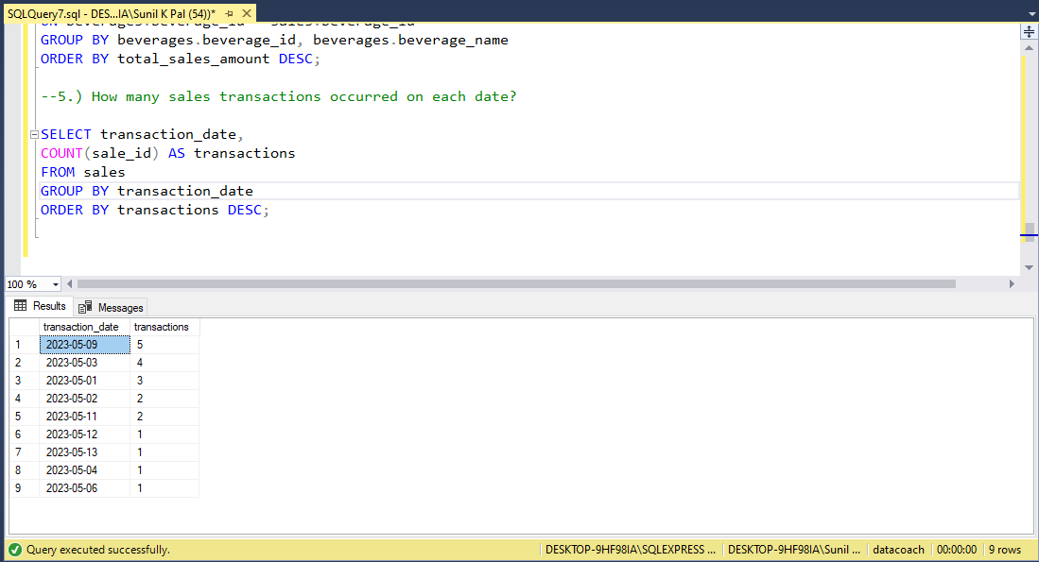
How many sales transactions occurred on each date?

Slide 7
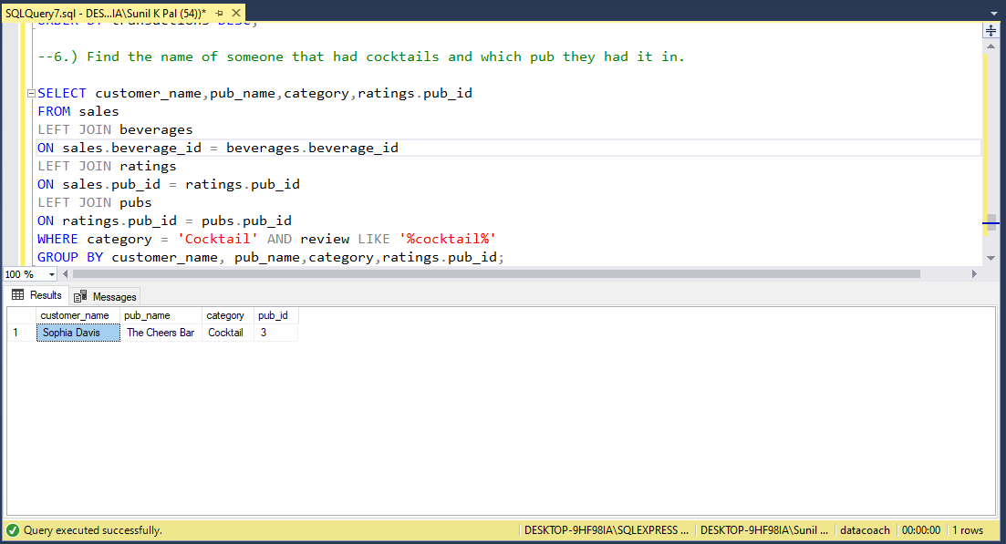
Find the name of someone that had cocktails and which pub they had it in.

Slide 8
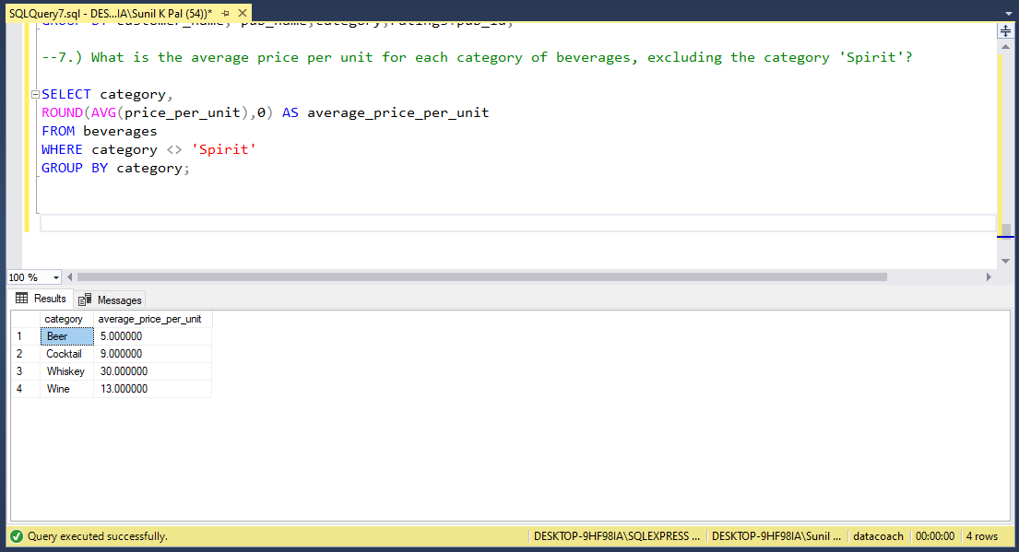
What is the average price per unit for each category of beverages, excluding the category 'Spirit'?

Slide 9
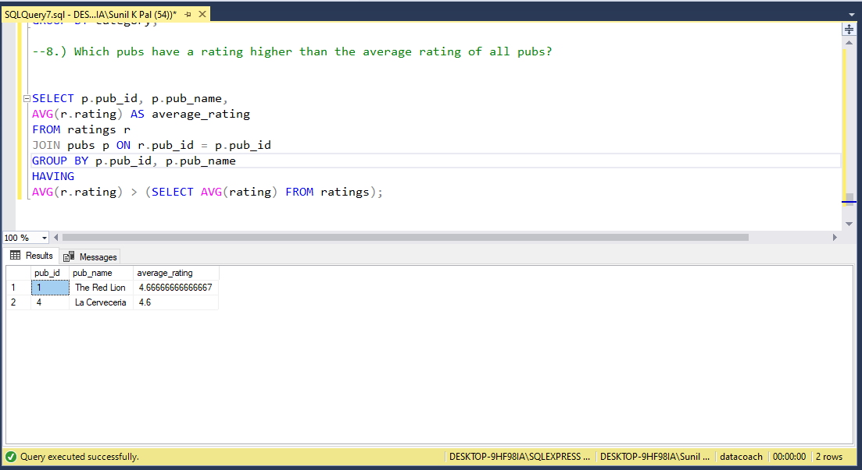
Which pubs have a rating higher than the average rating of all pubs?

Slide 10
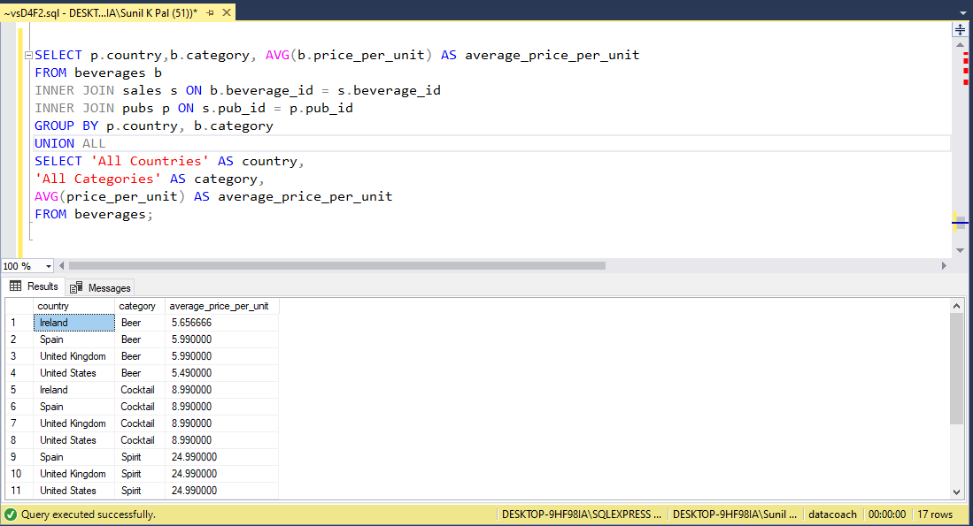
For each country, what is the average price per unit of beverages in each category, and what is the overall average price per unit of beverages across all categories?

Slide 11
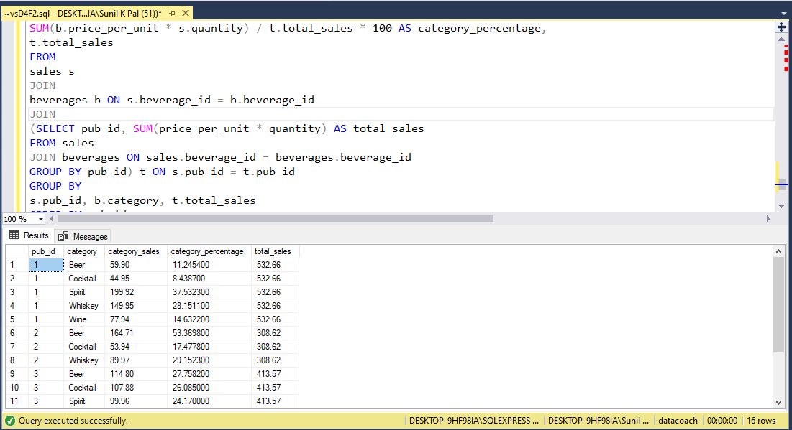
For each pub, what is the percentage contribution of each category of beverages to the total sales amount, and what is the pub's overall sales amount?

